Slide 1
Script Encoder Decoder
- Adarsh Anand, Anuj Popli
Manager - Arvindh Sabapathy
Mentor - Bhageerath Arasachetty
Mentor – Shyam Prasad

Slide 2
Agenda
Problem Statement
Project Design
Road Map to project
Technology Exposure
Tools
Demo

Slide 3
Identify and Encode potentially harmful and vulnerable tags in HTML documents through a Java application. Giving user the flexibility to encode as well as decode the tags and scripts which posses the risk to make the document unsafe.
Problem Statement

Slide 4
Project Design
Encoding / Decoding
Output File
Script Encoder/Decoder
Reads the files in fixed memory blocks for memory optimization
Uses Regex functions to find patterns and encoding the occurrences
Hence disabling the potentially harmful scripts
Writing to Output File
Input HTML Files
Working Directory
Encoding / Decoding
Output File
Writing to Output File
Executor Framework
Spawns Threads
Passes the File Paths and Configurations to
Individual thread
Encoding / Decoding
Output File
Writing to Output File
Encoding / Decoding
Output File
Writing to Output File
Script Data Binder
Reads configuration passed by the user and creates suitable Data Structures.
Encoding / Decoding
Output File
Writing to Output File
THREADS

Slide 5
Roadmap
To the
Project

Slide 6
Week 1
Learnt about Java and setup Eclipse
Created a rudimentary code for finding <script> tags and encoding them
Created a ScriptDataBinder class for accessing a configuration file for encoding using a Hashmap of Hashmaps as table
Week 3
Created ScriptEncoder class which reads the input files, encodes/decodes the same and writes the processed file to output folder.
Used Regex function and Patter Matcher in Java to identify the tag patterns.
Using .htm configuration tables for user friendly experience for modifying the configurations
Week 2

Slide 7
Week 5
Week 6
Using and multithreading to simultaneously process many files making the process time efficient.
Reading whole JExecutor Framework ava File in fixed size blocks which makes our program memory efficient and able to handle large files
Creating tag separated HTML file for all 2600 payloads
Learning about SVN repository and using Tortoise SVN to upload our code files into Oracle Server
Learning about Java Logger and the log4j logger, and then used Java Logger in the program instead of SysOut Functions to manage the logs more efficiently
Successfully testing the code for complete payloads
Reading about and Configuring the log4J logger to log information in log files instead of console.
Creating a separate Script Encoder Decoder Main file which provides functionality to the user to access the program passing the input files and features to be incorporated
Creating executable JAR files file and testing the same with the all payloads
Week 4

Slide 8
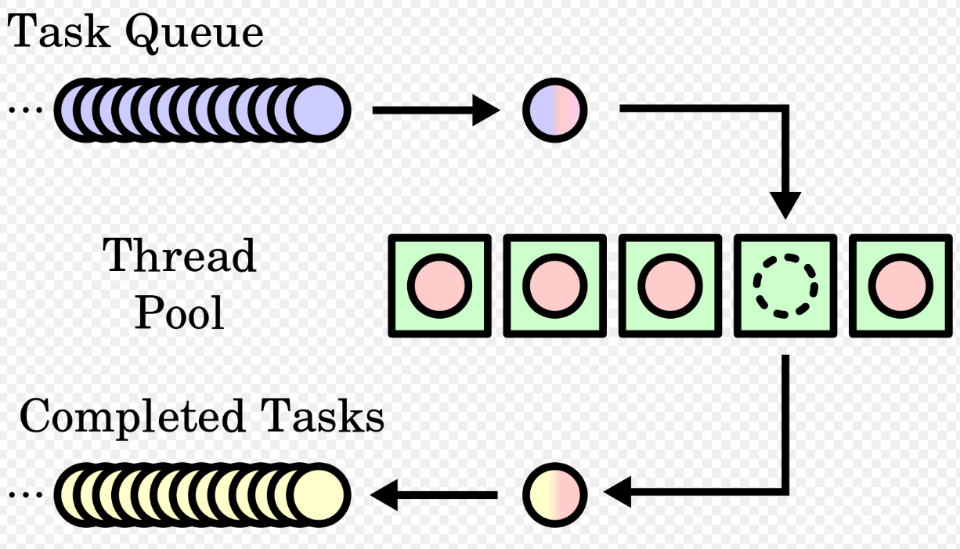
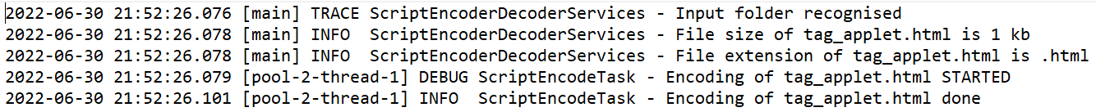
Technology Exposure
Regex for tag identification in encoding/decoding
Executor Framework for thread pooling
"(<|</)" + tag + "[^>]*" + ">"
<script src=1 onerror="javascript:alert(1)">
Log4j for writing logs and maintaining logs

Slide 9



Tools used
Eclipse as an IDE and a project management tool
Beyond Compare as tool to manage and edit source code
SVN as a repository manager for sharing files among the team

Slide 10
Demo

Slide 11
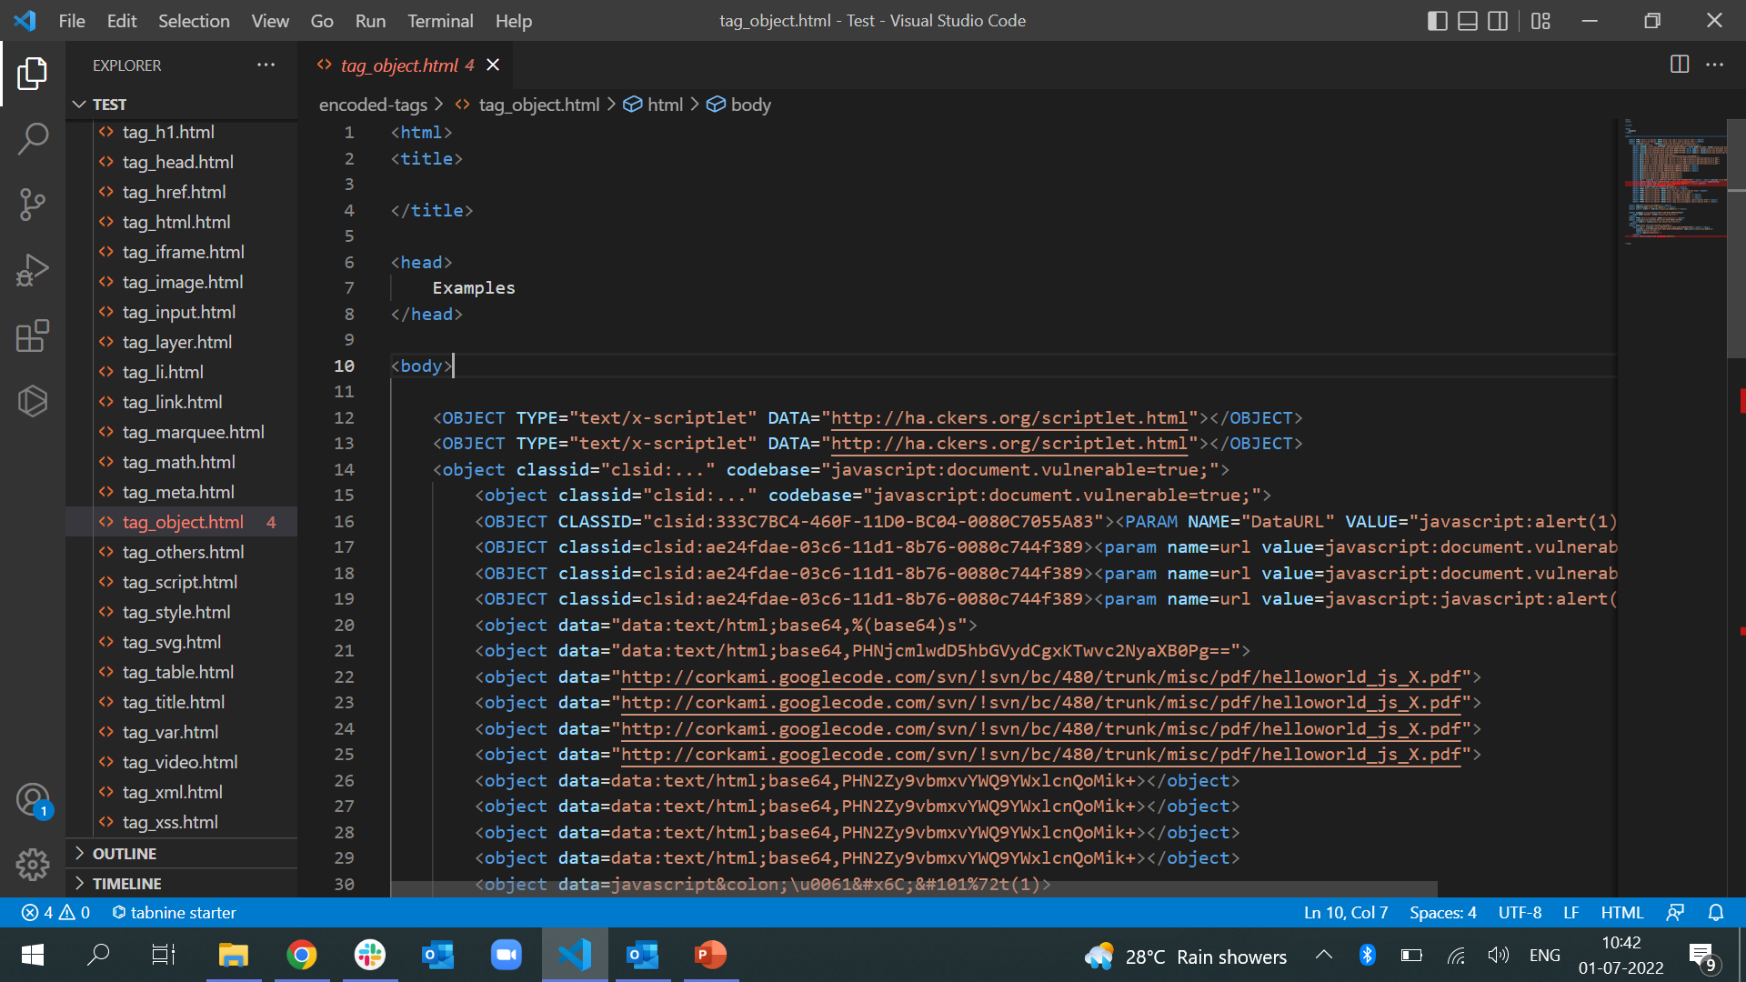
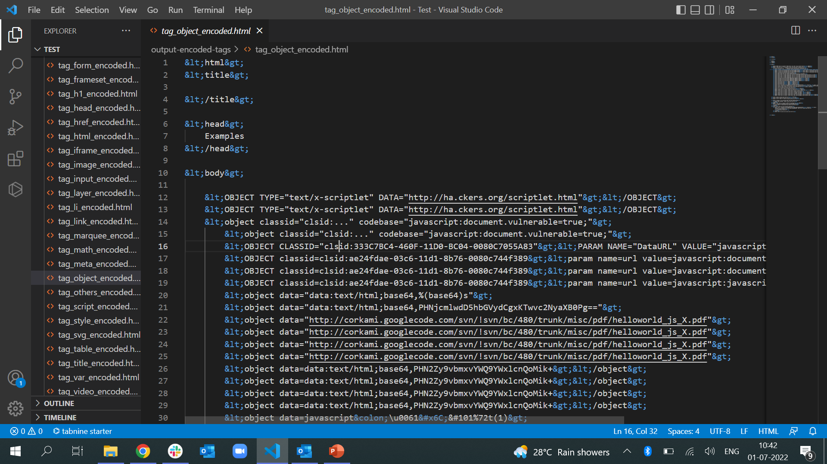
Original HTML file passed to the JAVA program
Encoded File in which tags have been replaced by escape characters

Slide 12
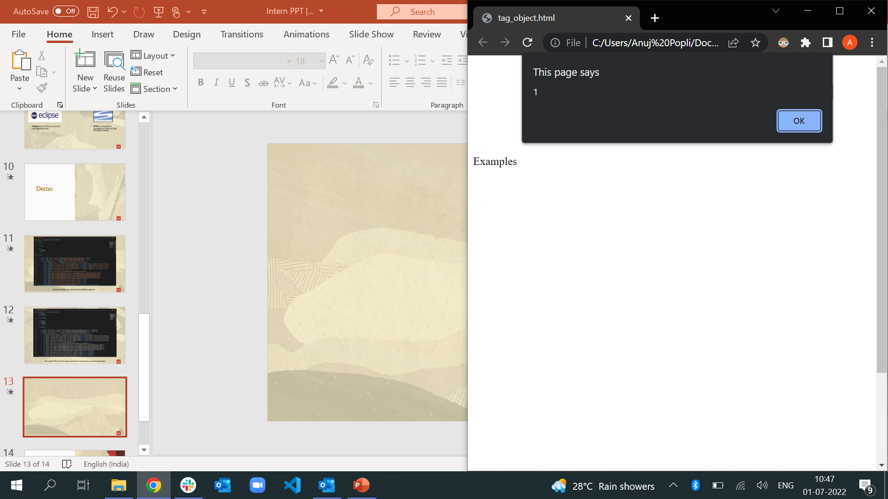
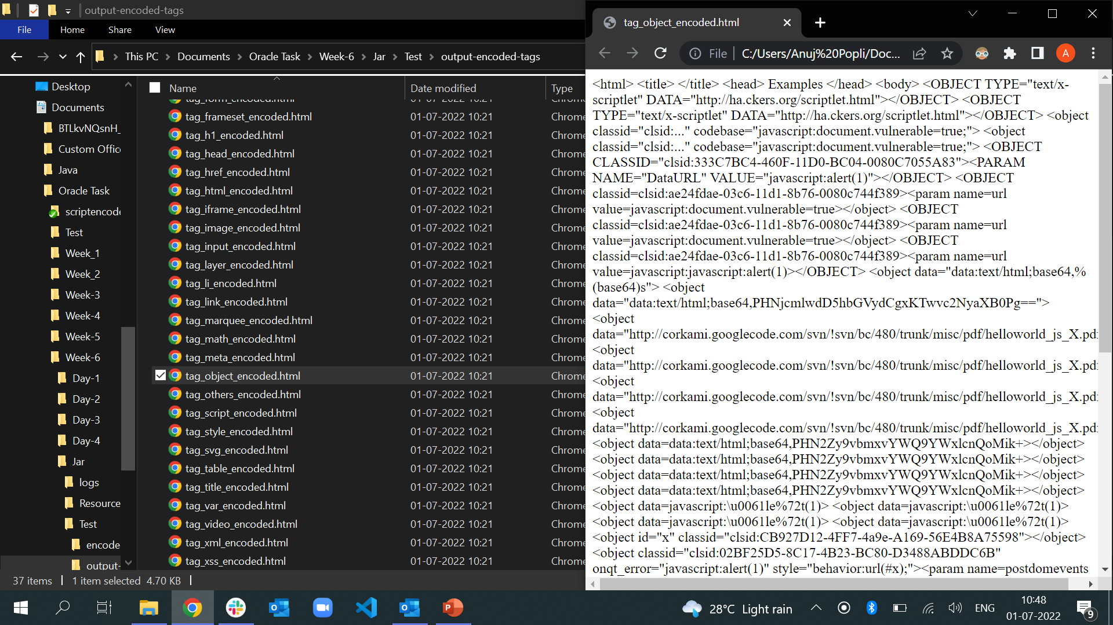
Loading Original File in web browser
Loading Encoded File in web browser

